Slide 1
Medical project IN-STK5000

Slide 2

Overview of the project
Dataset: n = 10 000 and p = 130
Sex, smoker, genes(126), symptoms(2)
Actions, type of treatment
Outcome, no effect, measurable effect
We want a policy that maximizes
$$U= \sum_{t=1}^{T}{r_{t}}, r_{t}≡−0.1a_{t}+ y_{t}$$

Slide 3
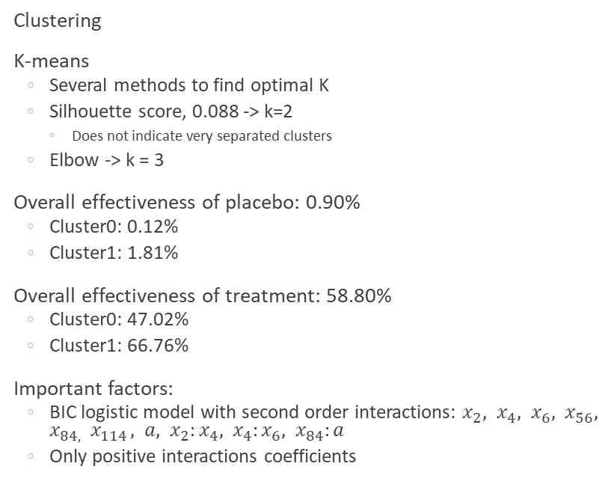
Part 1 Part 2
Clustering
K-means
Several methods to find optimal K
Silhouette score, 0.088 -> k=2
Does not indicate very separated clusters
Elbow -> k = 3
Overall effectiveness of placebo: 0.90%
Cluster0: 0.12%
Cluster1: 1.81%
Overall effectiveness of treatment: 58.80%
Cluster0: 47.02%
Cluster1: 66.76%
Important factors:
BIC logistic model with second order interactions: $x_{2}, x_{4}, x_{6}, x_{56}, x_{84, } x_{114 }, a, x_{2}:x_{4}, x_{4}:x_{6}, x_{84}:a$
Only positive interactions coefficients
Improved policies
Historical utility: 1191,2 (mean 0.11912)
Bootstrap 95% CI: [1127.9075, 1261.5225]
Improved policies: logistic model, neural network
Increase robustness of model
Bootstrap probability consensus for logistic model
Tuning hidden layers configurations with CV for neural network
Estimated utility:
logistic: 0.427319
NN: 0.465482
True utility:
logistic:
NN: 0.441900

Slide 4
Part 3
Test Bench
Fixed seed, same patients, but different recommenders.
Otherwise, very variable results.
n_test = 100
Historical Recommender:
95% empirical CI [5.1, 17.5]
Improved recommender:
Logistic boot no (regular logistic was equally good) [36.68, 56.93]
NN no update (5,2)
Placebo
Treatment 1
Random
Adaptive recommender (same treatments) (if max treated people, model always give drug)
Logistic boot (cluster, same results)
Neural Network (cluster slightly worse results, less training data)
New Treatments: (1 og 2 har snit og disjunkte deler)
Logistic force, doesn’t work. Always drug2
NN force very good
Cheat
Notes:
In this part we are going to test our models on new patients.
One remark. We have fixed a seed such that each model recommend an action for the same patients. We now this is not realistic in the real world. However, the results we got when we looked at different patients varied a lot. We observed that a recommender that was the best in one run would be the worst in the next one. We could have increased the number of patients, but the code had a long running time.
First we test the historical recommender. We see that we obtain a 95% CI from 5.1 to 17.5. Better [8,96, 12,79] with n_test 1000. That is quite a wide interval. Maybe due to the low number of n-test. Either way. We see that the historical is situated in the middle.
Logisticboost =

Slide 5
Analysis of the 10 best treatments
Treatment | Utility | Success: | %gen 0 | %gen 1 | Fail: | %gene 0 | %gene 1 | Success rate gene0 gene1
2 | 4443 | 5443 |  |  | 4557 |  |  | 0.554
1 | 4341 | 5341 |  |  | 4659 |  |  | 0.534
0 | 140 | 140 |  |  | 9860 |  |  | 0.014
127 | -94 | 906 | 0.091 | 0.909 | 9094 | 0.448 | 0.552 | 0.020 0.141
86 | -397 | 603 | 0.221 | 0.799 | 9397 | 0.531 | 0.469 | 0.026 0.096
28 | -620 | 380 | 0.463 | 0.537 | 9620 | 0.493 | 0.507 | 0.036 0.040
26 | -632 | 368 | 0.139 | 0.861 | 9632 | 0.517 | 0.483 | 0.010 0.064
11 | -646 | 354 | 0.136 | 0.864 | 9646 | 0.516 | 0.484 | 0.010 0.062
9 | -666 | 334 | 0.266 | 0.734 | 9666 | 0.512 | 0.488 | 0.018 0.049
92 | -685 | 315 | 0.441 | 0.559 | 9685 | 0.503 | 0.497 | 0.028 0.035
Notes:
Here we have analyzed the effect of the treatments. We have given each treatment to different 10 000 people, but each treatment is given to the same 10 000 people. This is not possible in the real world, but in our sandbox fictive world.
From here we see that treatment number 2 is slightly better than treatment 1 for the general population. While the gene specific treatments all yield negative utility. This means that they do not work as often as the other two. Actually, the utility of the placebo is better even though we have treated less patients.
There is one thing we want to point out here. Look at treatment 127. Given that it was a success we can see that gen at index 125 with high probability is 1. 91%. However. This doesn’t mean that we should give treatment 127 to someone with gene125, as we can see here, the prob of success is just 0.141. Much less than treatment 1 and 2.

Slide 7
Further investigation
Look at different costs for different treatments

